Slide 1
Conditional Generation by RNN & Attention
Hung-yi Lee
李宏毅

Slide 2
Outline
Generation
Attention
Tips for Generation
Pointer Network
Notes:
Generation: pixel RNN?
Conditional generation: Shawn
Attention:?

Slide 3
Generation
Generating a structured object component-by-component
Notes:
http://www.thespermwhale.com/jaseweston/ram/

Slide 4




Generation
http://youtien.pixnet.net/blog/post/4604096-%E6%8E%A8%E6%96%87%E6%8E%A5%E9%BE%8D%E4%B9%8B%E5%B0%8D%E8%81%AF%E9%81%8A%E6%88%B2
Sentences are composed of characters/words
Generating a character/word at each time by RNN
床
前
明
月
$$\sim$$
sample
$$\sim$$
$$\sim$$
$$\sim$$
P(w₁)
P(w₂|w₁)
P(w₃|w₁,w₂)
P(w₄|w₁,w₂,w₃)
……
……
床
前
明
……
<BOS>
w₁
w₂
w₃
Notes:
E.g. sentences are composed of words

Slide 5




Generation
Consider as a sentence
blue
red
yellow
……
gray
Train a language model based on the “sentences”
Images are composed of pixels
Generating a pixel at each time by RNN
red
blue
pink
blue
$$\sim$$
$$\sim$$
$$\sim$$
$$\sim$$
P(w₁)
P(w₂|w₁)
P(w₃|w₁,w₂)
P(w₄|w₁,w₂,w₃)
……
……
red
blue
pink
……
<BOS>
w₁
w₂
w₃
Notes:
(simply replacing words with color)

Slide 6
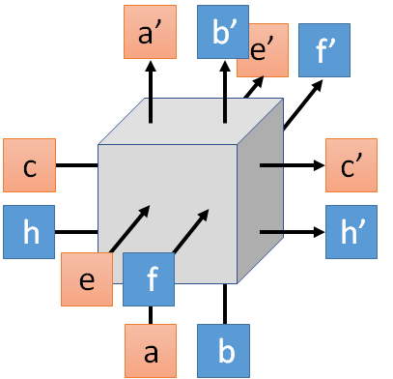
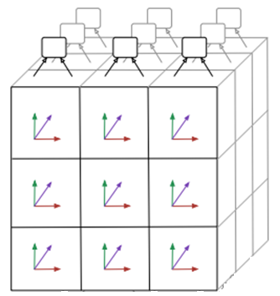
Generation
3 x 3 images
Images are composed of pixels

Slide 7
Generation
Image
Aaron van den Oord, Nal Kalchbrenner, Koray Kavukcuoglu, Pixel Recurrent Neural Networks, arXiv preprint, 2016
Aaron van den Oord, Nal Kalchbrenner, Oriol Vinyals, Lasse Espeholt, Alex Graves, Koray Kavukcuoglu, Conditional Image Generation with PixelCNN Decoders, arXiv preprint, 2016
Video
Aaron van den Oord, Nal Kalchbrenner, Koray Kavukcuoglu, Pixel Recurrent Neural Networks, arXiv preprint, 2016
Handwriting
Alex Graves, Generating Sequences With Recurrent Neural Networks, arXiv preprint, 2013
Speech
Aaron van den Oord, Sander Dieleman, Heiga Zen, Karen Simonyan, Oriol Vinyals, Alex Graves, Nal Kalchbrenner, Andrew Senior,Koray Kavukcuoglu, WaveNet: A Generative Model for Raw Audio, 2016

Slide 8
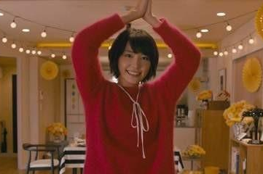


Conditional Generation
We don’t want to simply generate some random sentences.
Generate sentences based on conditions:
Caption Generation
Given condition:
“A young girl is dancing.”
Chat-bot
“Hello”
“Hello. Nice to see you.”
Given condition:
Notes:
Wavnet is the same

Slide 9
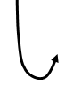

Conditional Generation
Represent the input condition as a vector, and consider the vector as the input of RNN generator
Image Caption Generation
A
woman
. (period)
A vector
<BOS>
CNN
……
Input image

Slide 10
Conditional Generation
Sequence-to-sequence learning
Represent the input condition as a vector, and consider the vector as the input of RNN generator
E.g. Machine translation / Chat-bot
machine
learning
. (period)
Information of the whole sentences
機
器
學
習
Encoder
Jointly train
Decoder
Notes:
Video caption is the same

Slide 11

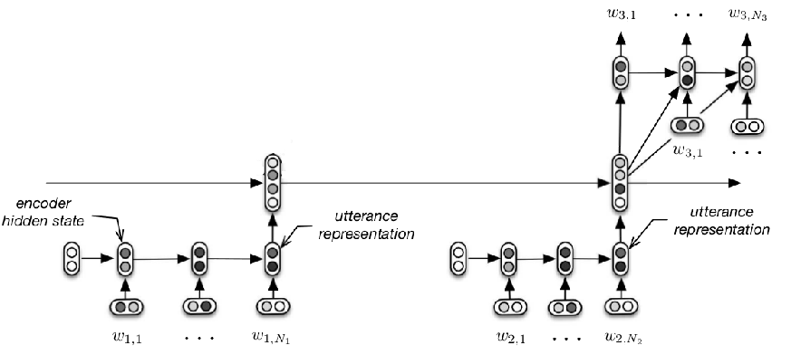
Conditional Generation
M: Hi
M: Hello
Need to consider longer context during chatting
U: Hi
M: Hi
https://www.youtube.com/watch?v=e2MpOmyQJw4
M: Hello
U: Hi
Serban, Iulian V., Alessandro Sordoni, Yoshua Bengio, Aaron Courville, and Joelle Pineau, 2015 "Building End-To-End Dialogue Systems Using Generative Hierarchical Neural Network Models.

Slide 12
Attention
Dynamic Conditional Generation
Notes:
http://www.thespermwhale.com/jaseweston/ram/

Slide 13
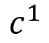
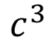
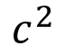
Dynamic Conditional Generation
Encoder
Decoder
Information of the whole sentences
machine
learning
. (period)
機
器
學
習
$$c^{1}$$
$$c^{2}$$
$$c^{3}$$
Notes:
Video caption is the same

Slide 14
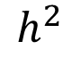
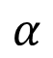
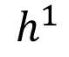
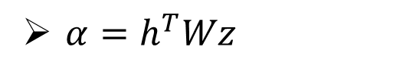
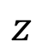
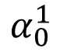
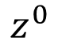
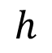
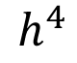
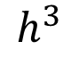
Machine Translation
$$α$$
Jointly learned with other part of the network
match
Attention-based model
$$h$$
$$z$$
$$α_{0}^{1}$$
match
What is ?
match
$$z^{0}$$
Design by yourself
Cosine similarity of z and h
$$h^{1}$$
$$h^{2}$$
$$h^{3}$$
$$h^{4}$$
Small NN whose input is z and h, output a scalar
機
器
學
習
$α=h^{T}Wz$
Notes:
Word vector

Slide 15
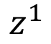
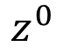
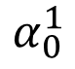
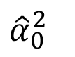
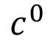
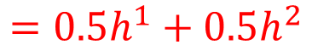
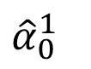
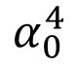
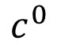
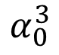
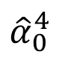
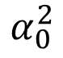
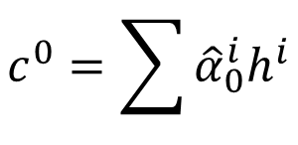
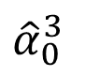
Machine Translation
Attention-based model
machine
$$c^{0}$$
0.5
$${\hat{α}}_{0}^{1}$$
0.5
$${\hat{α}}_{0}^{2}$$
0.0
$${\hat{α}}_{0}^{3}$$
0.0
$${\hat{α}}_{0}^{4}$$
$$z^{0}$$
$$z^{1}$$
softmax
$$α_{0}^{1}$$
$$α_{0}^{2}$$
$$α_{0}^{3}$$
$$α_{0}^{4}$$
$$c^{0}$$
Decoder input
$$h^{1}$$
$$h^{2}$$
$$h^{3}$$
$$h^{4}$$
$$c^{0}=\sum{{\hat{α}}_{0}^{i}h^{i}}$$
機
器
學
習
$$=0.5h^{1}+0.5h^{2}$$
Notes:
Word vector

Slide 16
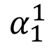
Machine Translation
Attention-based model
machine
$$α_{1}^{1}$$
match
$$z^{0}$$
$$z^{1}$$
$$c^{0}$$
$$h^{1}$$
$$h^{2}$$
$$h^{3}$$
$$h^{4}$$
機
器
學
習
Notes:
Word vector

Slide 17
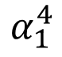
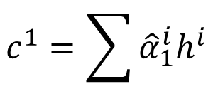
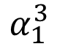
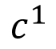
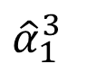
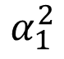
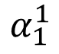
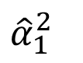
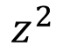
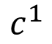
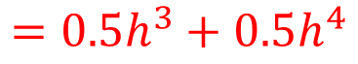
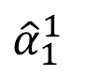
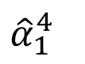
Machine Translation
Attention-based model
machine
learning
$$c^{1}$$
0.0
$${\hat{α}}_{1}^{1}$$
0.0
$${\hat{α}}_{1}^{2}$$
0.5
$${\hat{α}}_{1}^{3}$$
0.5
$${\hat{α}}_{1}^{4}$$
$$z^{0}$$
$$z^{1}$$
$$z^{2}$$
softmax
$$α_{1}^{1}$$
$$α_{1}^{2}$$
$$α_{1}^{3}$$
$$α_{1}^{4}$$
$$c^{0}$$
$$c^{1}$$
$$h^{1}$$
$$h^{2}$$
$$h^{3}$$
$$h^{4}$$
$$c^{1}=\sum{{\hat{α}}_{1}^{i}h^{i}}$$
機
器
學
習
$$=0.5h^{3}+0.5h^{4}$$
Notes:
Word vector

Slide 18
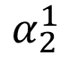
Machine Translation
Attention-based model
machine
learning
……
$$α_{2}^{1}$$
……
match
$$z^{0}$$
$$z^{1}$$
$$z^{2}$$
$$c^{0}$$
$$c^{1}$$
……
$$h^{1}$$
$$h^{2}$$
$$h^{3}$$
$$h^{4}$$
The same process repeat until generating
機
器
學
習
. (period)
Notes:
Word vector

Slide 19
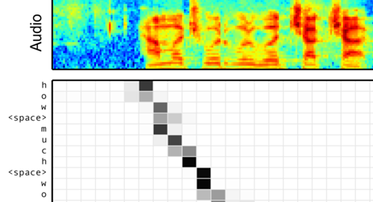
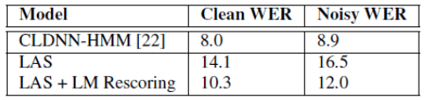
Speech Recognition
William Chan, Navdeep Jaitly, Quoc V. Le, Oriol Vinyals, “Listen, Attend and Spell”, ICASSP, 2016
Notes:
土撥鼠
撥

Slide 20
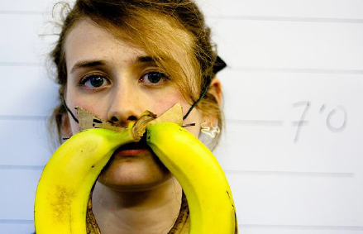

Image Caption Generation
A vector for each region
match
$$z^{0}$$
0.7
CNN
filter
filter
filter
filter
filter
filter
filter
filter
filter
filter
filter
filter

Slide 21

Image Caption Generation
Word 1
A vector for each region
$$z^{0}$$
$$z^{1}$$
CNN
filter
filter
filter
weighted sum
filter
filter
filter
0.7
0.1
0.1
0.1
0.0
0.0
filter
filter
filter
filter
filter
filter

Slide 22

Image Caption Generation
Word 1
Word 2
A vector for each region
$$z^{0}$$
$$z^{1}$$
$$z^{2}$$
weighted sum
CNN
filter
filter
filter
filter
filter
filter
0.0
0.8
0.2
0.0
0.0
0.0
filter
filter
filter
filter
filter
filter

Slide 23
Image Caption Generation
Kelvin Xu, Jimmy Ba, Ryan Kiros, Kyunghyun Cho, Aaron Courville, Ruslan Salakhutdinov, Richard Zemel, Yoshua Bengio, “Show, Attend and Tell: Neural Image Caption Generation with Visual Attention”, ICML, 2015
Notes:
Caption generation story like
How to do story like !!!!!!!!!!!!!!!!!!
http://www.cs.toronto.edu/~mbweb/
https://github.com/ryankiros/neural-storyteller

Slide 24
Image Caption Generation
Kelvin Xu, Jimmy Ba, Ryan Kiros, Kyunghyun Cho, Aaron Courville, Ruslan Salakhutdinov, Richard Zemel, Yoshua Bengio, “Show, Attend and Tell: Neural Image Caption Generation with Visual Attention”, ICML, 2015
Notes:
滑板相關詞
skateboarding
查看全部
skateboard
¹ Dr.eye譯典通
KK [ˋsket͵bord] DJ [ˋskeitbɔ:d]

Slide 25



Li Yao, Atousa Torabi, Kyunghyun Cho, Nicolas Ballas, Christopher Pal, Hugo Larochelle, Aaron Courville, “Describing Videos by Exploiting Temporal Structure”, ICCV, 2015
Notes:
Another application is summarization

Slide 26









Memory Network
Answer
$$=\sum_{n=1}^{N}{α_{n}x^{n}}$$
DNN
Sentence to vector can be jointly trained.
Extracted Information
$$α_{1}$$
$$α_{2}$$
$$α_{3}$$
$$α_{N}$$
Document
……
$$x^{N}$$
$$x^{1}$$
$$x^{2}$$
$$x^{3}$$
vector
Match
q
Query
Sainbayar Sukhbaatar, Arthur Szlam, Jason Weston, Rob Fergus, “End-To-End Memory Networks”, NIPS, 2015
Notes:
Conventional reading comprehension
Find support sentences
Answering
Find the suppor sentence by attentione-based model
All questions is QA
VQA is the same, not describe here

Slide 27









Memory
Network
Answer
$$=\sum_{n=1}^{N}{α_{n}h^{n}}$$
Extracted Information
DNN
Jointly learned
$$h^{1}$$
$$h^{2}$$
$$h^{3}$$
……
$$h^{N}$$
Hopping
$$α_{1}$$
$$α_{2}$$
$$α_{3}$$
$$α_{N}$$
Document
……
$$x^{N}$$
$$x^{1}$$
$$x^{2}$$
$$x^{3}$$
Match
q
Query
Notes:
Conventional reading comprehension
Find support sentences
Answering
Find the suppor sentence by attentione-based model
All questions is QA
VQA is the same, not describe here

Slide 28



Memory
Network
DNN
a
Extract information
……
……
Compute attention
Extract information
……
……
Compute attention
q

Slide 29
Wei Fang, Juei-Yang Hsu, Hung-yi Lee, Lin-Shan Lee, "Hierarchical Attention Model for Improved Machine Comprehension of Spoken Content", SLT, 2016

Slide 30

Neural Turing Machine
von Neumann architecture
Neural Turing Machine not only read from memory
Also modify the memory through attention
https://www.quora.com/How-does-the-Von-Neumann-architecture-provide-flexibility-for-program-development
Notes:
范紐曼型架構（英語：von Neumann architecture）
算術邏輯單元

Slide 31









Neural Turing Machine
y¹
h⁰
f
$$r^{0}=\sum{{\hat{α}}_{0}^{i}m_{0}^{i}}$$
x¹
r⁰
Retrieval process
$${\hat{α}}_{0}^{1}$$
$${\hat{α}}_{0}^{2}$$
$${\hat{α}}_{0}^{3}$$
$${\hat{α}}_{0}^{4}$$
Long term memory
$$m_{0}^{1}$$
$$m_{0}^{2}$$
$$m_{0}^{3}$$
$$m_{0}^{4}$$
Notes:
What is the different

Slide 32












Neural Turing Machine
y¹
h⁰
f
$$r^{0}=\sum{{\hat{α}}_{0}^{i}m_{0}^{i}}$$
x¹
r⁰
$$k_{}^{1}$$
$$e_{}^{1}$$
$$a_{}^{1}$$
$${\hat{α}}_{0}^{1}$$
$${\hat{α}}_{0}^{2}$$
$${\hat{α}}_{0}^{3}$$
$${\hat{α}}_{0}^{4}$$
$${\hat{α}}_{1}^{1}$$
$${\hat{α}}_{1}^{2}$$
$${\hat{α}}_{1}^{3}$$
$${\hat{α}}_{1}^{4}$$
softmax
$$m_{0}^{1}$$
$$m_{0}^{2}$$
$$m_{0}^{3}$$
$$m_{0}^{4}$$
$$α_{1}^{1}$$
$$α_{1}^{2}$$
$$α_{1}^{3}$$
$$α_{1}^{4}$$
$$α_{1}^{i}=cos\left(m_{0}^{i},k^{1}\right)$$
Notes:
What is the different

Slide 33

Neural Turing Machine
Real version

Slide 34













Neural Turing Machine
$$m_{1}^{i}$$
$$=$$
$$m_{0}^{i}$$
$${−\hat{α}}_{1}^{i}$$
$$e_{}^{1}$$
$$⨀$$
$$m_{0}^{i}$$
$${+\hat{α}}_{1}^{i}$$
$$a_{}^{1}$$
(element-wise)
$$k_{}^{1}$$
$$e_{}^{1}$$
$$a_{}^{1}$$
0 ~ 1
$${\hat{α}}_{0}^{1}$$
$${\hat{α}}_{0}^{2}$$
$${\hat{α}}_{0}^{3}$$
$${\hat{α}}_{0}^{4}$$
$${\hat{α}}_{1}^{1}$$
$${\hat{α}}_{1}^{2}$$
$${\hat{α}}_{1}^{3}$$
$${\hat{α}}_{1}^{4}$$
$$m_{0}^{1}$$
$$m_{0}^{2}$$
$$m_{0}^{3}$$
$$m_{0}^{4}$$
$$m_{1}^{1}$$
$$m_{1}^{2}$$
$$m_{1}^{3}$$
$$m_{1}^{4}$$
Notes:
What is the different

Slide 35








Neural Turing Machine
y¹
y²
h⁰
f
h¹
f
x¹
r⁰
x²
r¹
$${\hat{α}}_{0}^{1}$$
$${\hat{α}}_{0}^{2}$$
$${\hat{α}}_{0}^{3}$$
$${\hat{α}}_{0}^{4}$$
$${\hat{α}}_{1}^{1}$$
$${\hat{α}}_{1}^{2}$$
$${\hat{α}}_{1}^{3}$$
$${\hat{α}}_{1}^{4}$$
$${\hat{α}}_{2}^{1}$$
$${\hat{α}}_{2}^{2}$$
$${\hat{α}}_{2}^{3}$$
$${\hat{α}}_{2}^{4}$$
$$m_{0}^{1}$$
$$m_{0}^{2}$$
$$m_{0}^{3}$$
$$m_{0}^{4}$$
$$m_{1}^{1}$$
$$m_{1}^{2}$$
$$m_{1}^{3}$$
$$m_{1}^{4}$$
$$m_{2}^{1}$$
$$m_{2}^{2}$$
$$m_{2}^{3}$$
$$m_{2}^{4}$$
Notes:
What is the different!!!!!!!!!!!!!!!!!!???????????????????????

Slide 36
Tips for Generation
Notes:
Beam search
Safe
whole
http://www.thespermwhale.com/jaseweston/ram/
MMI/RL on chat-bot

Slide 37



















Attention
Kelvin Xu, Jimmy Ba, Ryan Kiros, Kyunghyun Cho, Aaron Courville, Ruslan Salakhutdinov, Richard Zemel, Yoshua Bengio, “Show, Attend and Tell: Neural Image Caption Generation with Visual Attention”, ICML, 2015
component
$$α_{t}^{i}$$
time
Bad Attention
$$α_{1}^{1}$$
$$α_{2}^{1}$$
$$α_{3}^{1}$$
$$α_{4}^{1}$$
$$α_{1}^{2}$$
$$α_{2}^{2}$$
$$α_{3}^{2}$$
$$α_{4}^{2}$$
$$α_{1}^{3}$$
$$α_{2}^{3}$$
$$α_{3}^{3}$$
$$α_{4}^{3}$$
$$α_{1}^{4}$$
$$α_{2}^{4}$$
$$α_{3}^{4}$$
$$α_{4}^{4}$$
w₁
w₂
(woman)
w₃
w₄
(woman)
…… no cooking
Good Attention: each input component has approximately the same attention weight
$$\sum_{i}{{\left(τ−\sum_{t}{α_{t}^{i}}\right)}^{2}}$$
E.g. Regularization term:
For each component
Over the generation

Slide 38

Mismatch between Train and Test
Reference:
Training
A
B
B
$$C=\sum_{t}{C_{t}}$$
A
A
A
B
B
B
Minimizing cross-entropy of each component
<BOS>
A
: condition
B

Slide 39
Mismatch between Train and Test
Generation
B
A
A
We do not know the reference
A
A
A
Testing: Output of model is the input of the next step.
B
B
B
Training: the inputs are reference.
<BOS>
A
Exposure Bias
B
Notes:
Exposure Bias
Why the name?

Slide 40



B
A
B
A
A
A
B
B
A
B
A
B
One step wrong
A
B
B
A
B
A
A
A
B
B
A
B
A
B
May be totally wrong
Never explore ……
A
B
一步錯，步步錯

Slide 41
Modifying Training Process?
Reference
When we try to decrease the loss for both step 1 and 2 …..
A
B
B
B
A
A
A
A
A
Training is matched to testing.
B
B
B
In practice, it is hard to train in this way.
A
A
B

Slide 42

Scheduled Sampling
A
Reference
B
B
A
A
A
A
B
B
B
A
B
from model
from model
A
From reference
From reference
B

Slide 43
Scheduled Sampling
Caption generation on MSCOCO
 | BLEU-4 | METEOR | CIDER
Always from reference | 28.8 | 24.2 | 89.5
Always from model | 11.2 | 15.7 | 49.7
Scheduled Sampling | 30.6 | 24.3 | 92.1
Samy Bengio, Oriol Vinyals, Navdeep Jaitly, Noam Shazeer, Scheduled Sampling for Sequence Prediction with Recurrent Neural Networks, arXiv preprint, 2015

Slide 44

Beam Search
The green path has higher score.
Not possible to check all the paths
A
B
A
B
A
A
B
B
0.4
0.6
0.9
0.4
A
B
0.6
A
B
0.9
0.6
A
B
0.4

Slide 45
Beam Search
Keep several best path at each step
Beam size = 2
A
B
A
B
A
A
B
B
A
B
A
B
A
B

Slide 46

Beam Search
The size of beam is 3 in this example.
https://github.com/tensorflow/tensorflow/issues/654#issuecomment-169009989

Slide 47
Better Idea?
U: 你覺得如何?
M: 高興想笑 or 難過想哭
高興
想笑
想笑≈想哭
B
A
high
score
B
A
高興≈難過
A
A
A
A
B
B
B
B
<BOS>
<BOS>
A
B
B
高興
高興≈難過

Slide 48




Object level v.s. Component level
Minimizing the error defined on component level is not equivalent to improving the generated objects
Ref: The dog is running fast
$$C=\sum_{t}{C_{t}}$$
A cat a a a
The dog is is fast
Cross-entropy of each step
The dog is running fast
Optimize object-level criterion instead of component-level cross-entropy.
object-level criterion: $R\left(y,\hat{y}\right)$
Gradient Descent?
$y$: generated utterance, $\hat{y}$: ground truth
Notes:
Can we do Gradient descent?

Slide 49










Reinforcement learning?
Start with observation $s_{1}$
Observation $s_{2}$
Observation $s_{3}$
Obtain reward $r_{1}=0$
Obtain reward $r_{2}=5$
Action $a_{1}$: “right”
Action $a_{2}$: “fire”
(kill an alien)
Notes:
SEQUENCE LEVEL TRAINING

Slide 50



Reinforcement learning?
$$reward:$$
R(“BAA”, reference)
$r=0$
$r=0$
Action taken
B
A
A
A
A
A
Actions set
B
B
B
<BOS>
A
observation
B
Marc'Aurelio Ranzato, Sumit Chopra, Michael Auli, Wojciech Zaremba, “Sequence Level Training with Recurrent Neural Networks”, ICLR, 2016
The action we take influence the observation in the next step

Slide 51
Scheduled sampling
reinforcement

Slide 52



DAD: Scheduled Sampling
MIXER: reinforcement

Slide 53
Pointer Network
Oriol Vinyals, Meire Fortunato, Navdeep Jaitly, Pointer Network, NIPS, 2015
Notes:
http://www.thespermwhale.com/jaseweston/ram/

Slide 54
Notes:
中譯「凸包」或「凸殼」。在多維空間中有一群散佈各處的點，「凸包」是包覆這群點的所有外殼當中，表面積暨容積最小的一個外殼，而最小的外殼一定是凸的。
http://www.csie.ntnu.edu.tw/~u91029/ConvexHull.html
二維平面上的凸包是一個凸多邊形，在所有點的外圍繞一圈即得凸包。另外，最頂端、最底端、最左端、最右端的點，一定是凸包上的點。

Slide 57


Slide 59
Applications
Jiatao Gu, Zhengdong Lu, Hang Li, Victor O.K. Li, “Incorporating Copying Mechanism in Sequence-to-Sequence Learning”, ACL, 2016
Caglar Gulcehre, Sungjin Ahn, Ramesh Nallapati, Bowen Zhou, Yoshua Bengio, “Pointing the Unknown Words”, ACL, 2016
Machine Translation
Chat-bot
User: X寶你好，我是宏毅
Machine: 宏毅你好，很高興認識你

